Slide 1
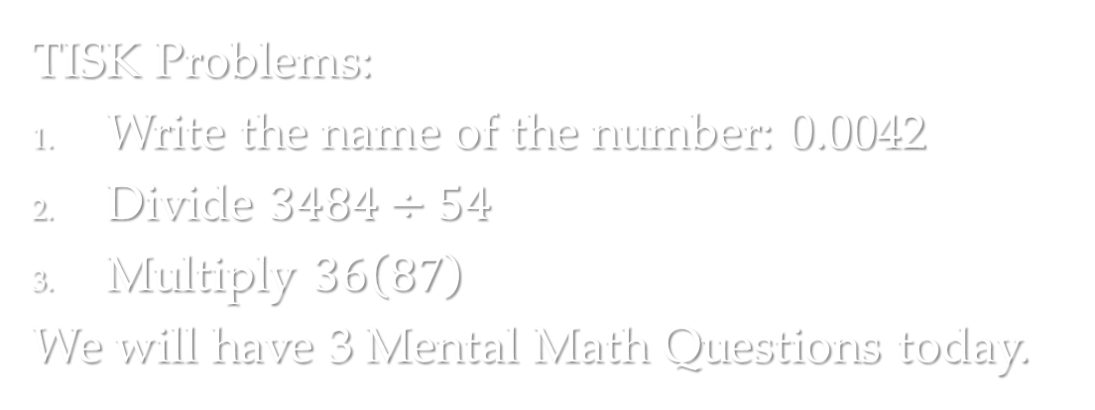
Tuesday, August 21, 2012
TISK Problems:
Write the name of the number: 0.0042
Divide $3484÷54$
Multiply $36\left(87\right)$
We will have 3 Mental Math Questions today.
Homework: p. 59 #36-39 all, 44-48all, 50-64 evens
Notes:
Find the product of 8 and 12. Divide by 2. Divide by 3. Find the positive square root. (Answer: 4)
Find the quotient of 92 and 4. Add 19. Divide by 6. (Answer: 7)
Find the sum of 87 and 54. Add 29. Find half. Find one fifth. (Answer: 17)

Slide 2
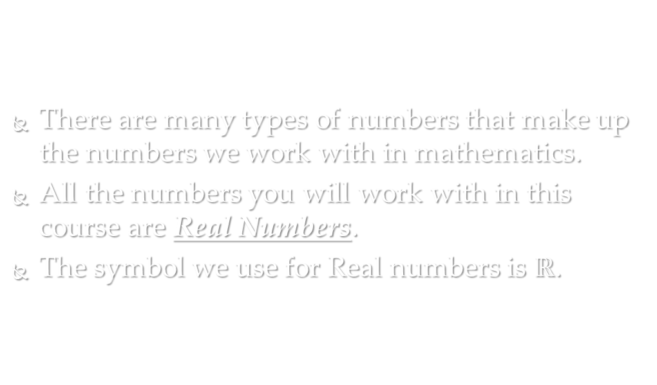
Number Systems
There are many types of numbers that make up the numbers we work with in mathematics.
All the numbers you will work with in this course are Real Numbers.
The symbol we use for Real numbers is $ℝ$.

Slide 3
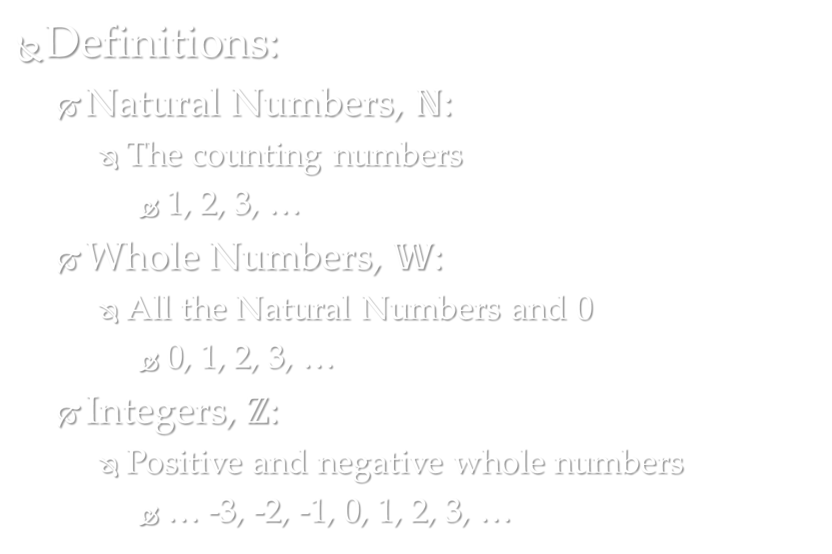
Number Systems
Definitions:
Natural Numbers, $ℕ$:
The counting numbers
1, 2, 3, …
Whole Numbers, $𝕎$:
All the Natural Numbers and 0
0, 1, 2, 3, …
Integers, $ℤ$:
Positive and negative whole numbers
… -3, -2, -1, 0, 1, 2, 3, …

Slide 4
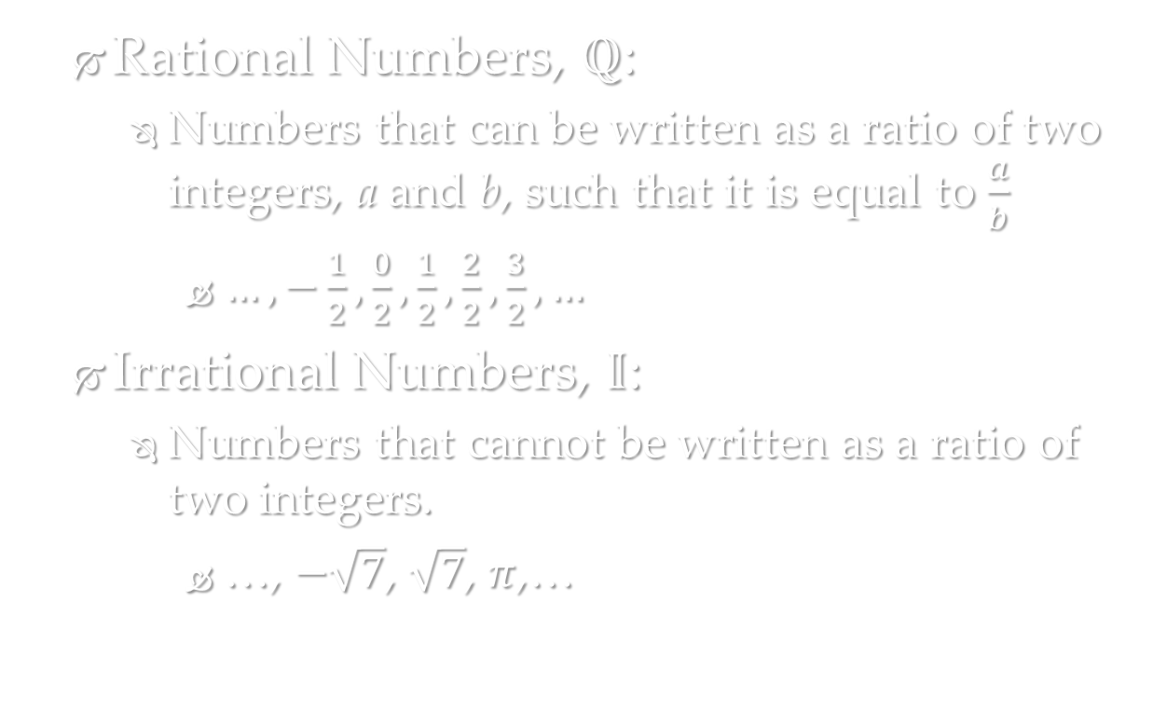
Number Systems
Rational Numbers, $ℚ$:
Numbers that can be written as a ratio of two integers, a and b, such that it is equal to $\frac{a}{b}$
$…,−\frac{1}{2},\frac{0}{2},\frac{1}{2},\frac{2}{2},\frac{3}{2},…$
Irrational Numbers, $𝕀$:
Numbers that cannot be written as a ratio of two integers.
…, $−\sqrt{7}$, $\sqrt{7}$, $π$,…

Slide 5










How do these systems fit together?
$$ℝ$$
$$ℚ$$
$$𝕀$$
$$ℤ$$
$$\frac{3}{4}$$
$$−4$$
$$\sqrt{24}$$
$$𝕎$$
$$\sqrt{9}$$
$$ℕ$$
Notes:
Check Understanding: Where does ____ go?
-4 (Integers)
$\sqrt{9}$ (Natural)
$3/4$ (Rational)
$\sqrt{24}$ (Irrational)

Slide 6
Absolute Value
Absolute Value
Definition: the distance a number is away from zero.
-5
-10
-5
5
10
0
5 units away from zero
So, the absolute value of -5 is 5.

Slide 7
Symbols
We use the | | bars to indicate absolute value.
So, the absolute value of -5 would be written like so:

Slide 8
Check Point.
Find the absolute value of each of the given numbers:
-8
12
-17
5
-3.2
4.1

Slide 9
Opposites
Two numbers that have the same absolute value are said to be opposites.
-30
0
30
30 units
30 units
So, -30 and 30 are opposites.

Slide 10
Check Point.
State the opposite of the given numbers.
32
-8
7.2
-4.9
81
0

Slide 11
Evaluating Absolute Value Expressions
When you have expressions with absolute value signs, you always evaluate the absolute value signs first!

Slide 12
Check Point.
Evaluate the expressions when x = -2.

Slide 13
Homework
p. 59 #36-39 all, 44-48all, 50-64 evens

